Slide 1
400D SAWS Final Presentation
Presented by
12/18/17

Slide 2
Team Members
Matt Rosales (Project Manager)
Developed project schedules and responsibilities
Procured cost estimates and budget constraints
Coordinated team meetings
Assisted with power requirements, power connections
Jordan Hsu (Power/Design Engineer)
Developed power requirements
Designed power distribution System
Built power connections

Slide 3
Team Members
Garrett Bondoc (Software Engineer)
Programming solar tracking algorithms
Integrating separate program functions
Building the hub
James Donahue (Hardware/Design Engineer)
Designing the hub
Building the hub
Constructing the gantry
Developing Solar tracking algorithm

Slide 4
Team Members
Sakib Karim (Systems Engineer)
Developed system requirements
System testing
Gantry Design
Bluetooth connection

Slide 5
Concept
Tracks remote weather changes. For use in outdoor safety, maritime shipping, forestry, etc
Records temperature, humidity, pressure, and UV intensity measurements.
Powered by a 10 watt tracking solar array.
It is portable and can be transported or relocated
Easily deployed in remote areas with no infrastructure

Slide 6
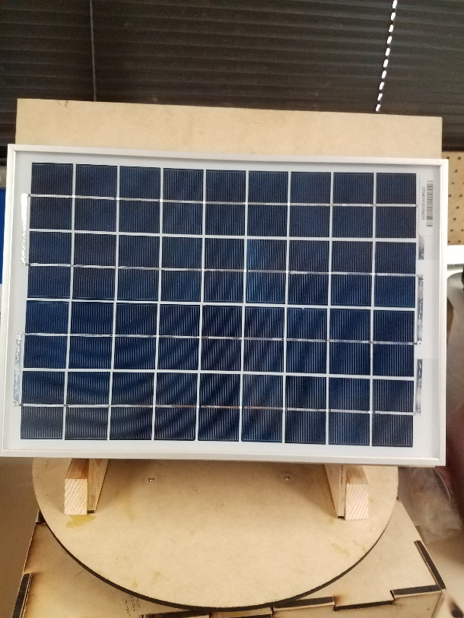
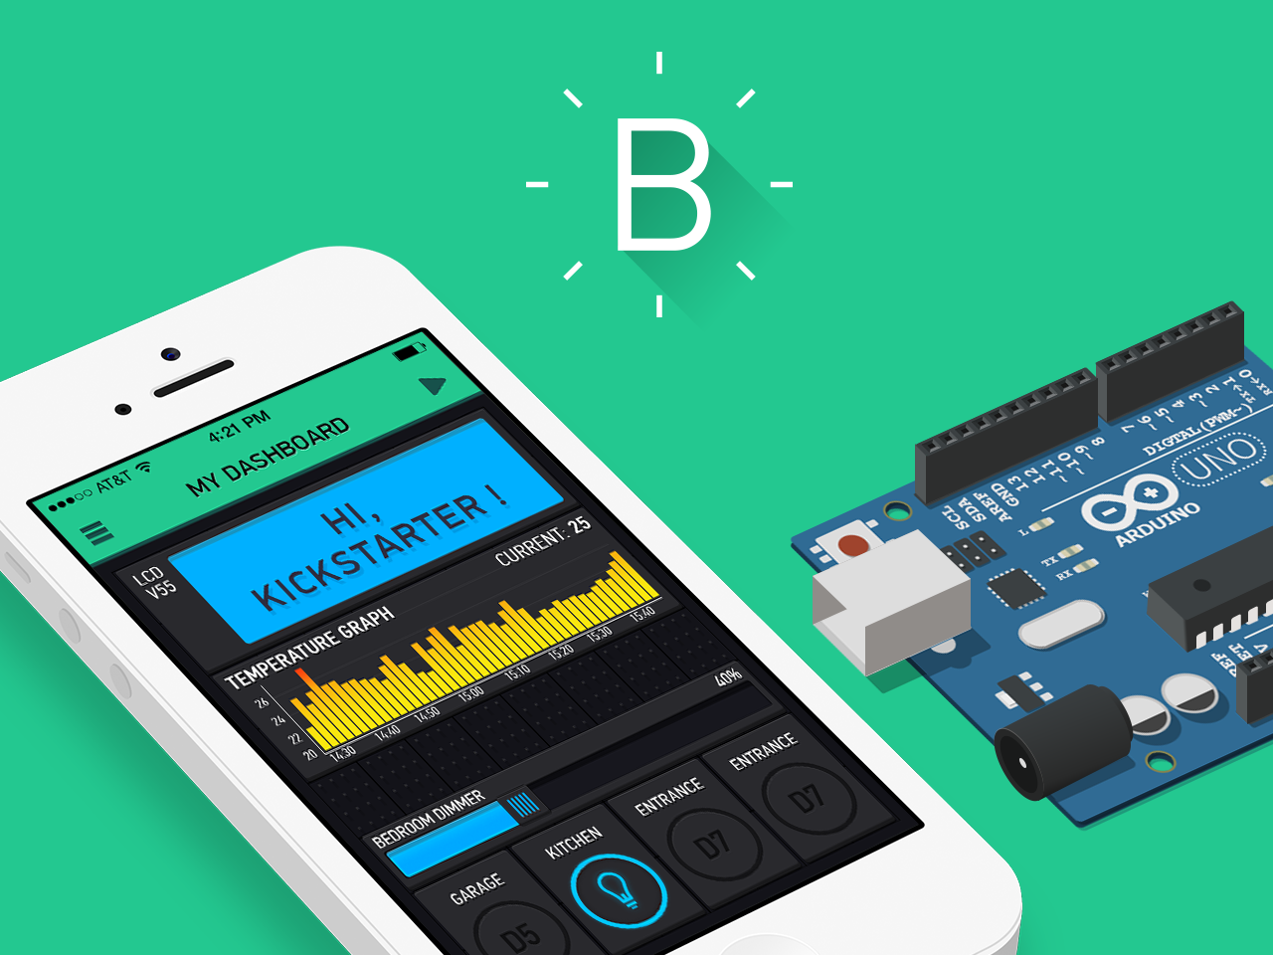
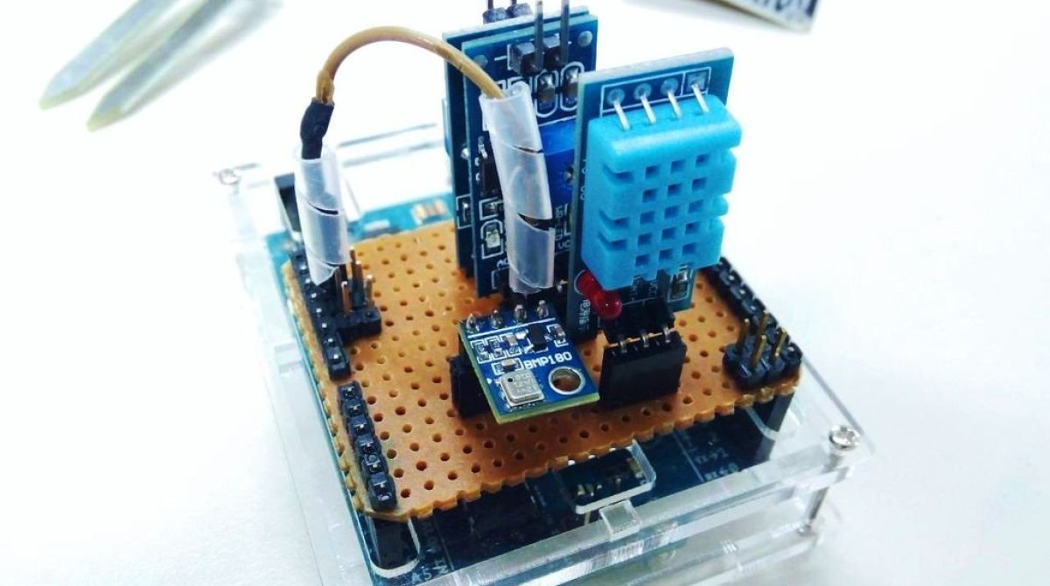
Concept Diagram
Figure 1. Concept Diagram
This is a visual representation of the system at its highest level which consists of the solar panel segment, the hub, and the user console

Slide 7
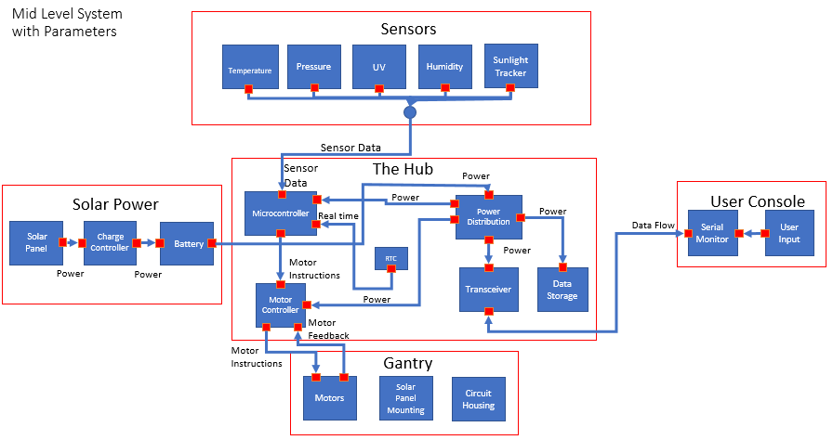
Figure 2. Mid-Level System. The diagram provides a more in depth look at each component of the high level system. The solar panel charges the battery; the battery provides power to the power distribution system of the hub, which then feeds power to the rest of the hub. The various sensors each read data to the hub’s microcontroller. All that real time data flows to both the data storage system and transceiver. The transceiver transmits the data to the user console. The hub’s microcontroller provides instructions to the motor controller; the hub’s motor controller then sends instructions to the motors on the gantry.

Slide 8
Acceptance Testing Results

Slide 9
Final Parts List Cost
Arduino Mega 2560 Rev3……………………………………………………………………………….. $38.50
BME280 sensor ………………………………………………………………….............................. $19.95
UV sensor ……………………………………………………………………………………………………. $8.10
Charge Controller …………………………………………………………………………………………. $16.95
Solar panel 10W 12V …………………………………………………………………………………….. $25.99
Real Time Clock…………………………………………………………………………………………… $9.90
NEMA 17 Stepper Motors…………………………………………………………………............... $39.00
Bluetooth Transceiver ……………………………………………………….......……………………… $19.99
16GB SD card…………………………………………………………………………….…………………… $7.66
Photoresistor ……………………………………………………………………………………………….. $5.99
Sealed Lead Acid Battery……………………………………………………………………………….. $15.99
Stepper Driver board…………………………………………………………………………………… $16.39
MicroSD breakout………………………………………………………………………………………….. $8.84
JST Connector – SH 6 PIN…………………………………………………………………………… $1.90
JST Connector – S2B-PH-K-S(LF)(SN)………………………………………………………… $1.90
MDF material………………………………………………………………………...............................$22.92
Hardware & Supplies………………………………………………………………......................... $14.97
Tb6612 driver…………………………………………………………………………………………………….$8.02
Tb6612 driver……………………………………………………………………………………………………$8.40
Total__________________________________________________________ $291.36

Slide 10
Demonstration

Slide 11
Questions?

